Slide 1
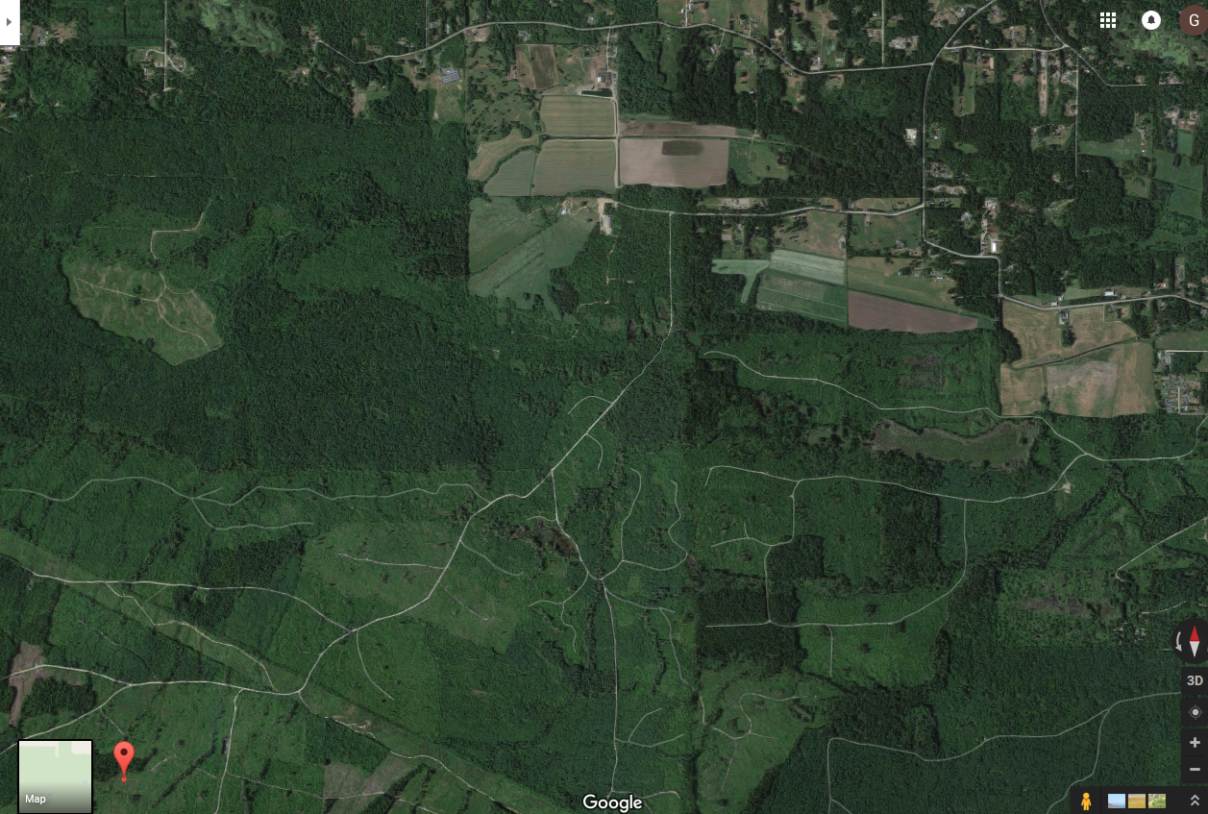
Errington Road
1.0 km
GATE
Fisher Road
Fisher mainline
12-42
Quarry
Power line
Parksville AMAT

Slide 2
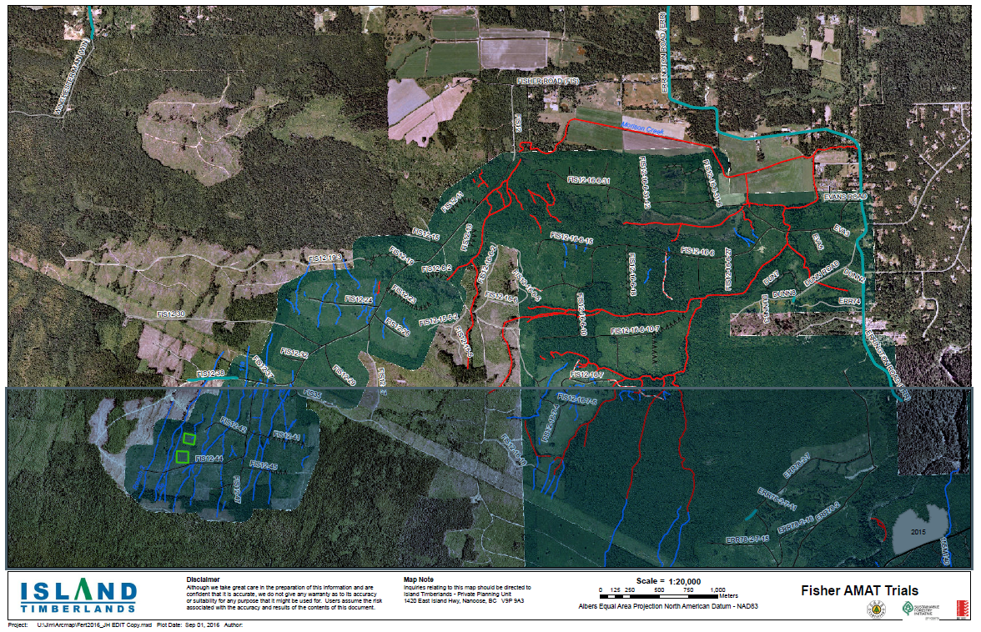
AMAT

